Slide 1



AES
Add-on processor for RISC-V
Students: David Dan
Dolev Vaknin
Supervisor: Eric Herbelin

Slide 2
abstract
In our days, where we use sensors and processors anywhere and anytime, it’s getting
very hard to keep our data safe.
There are a lot of chances to steal the information between collecting the raw data by a sensor, and encryption of that data by our processor.
The goal of this project is to design and implement an AES encryption (or any other safe encryption method) inside RISC-V processor, which can be positioned adjacent to a sensor.
In this project we are using RI5CY core embedded in Pulpenix microcontroller.
Introduction
AES algorithm
Workflow
Performance
Simulation

Slide 3
background
RISC-V
Open ISA
Founded by University of Berkeley, California.
Adopted by many in both academy and industry.
PULP
Parallel Ultra Low Power open-source computing platform
A collaboration of ETH Zurich and University of Bologna.
PULPino
Based on PULP platform.
Uses RI5CY core.
PULPeniX
Developed in Bar Ilan, Enics lab.
A HW and SW development and simulation environment.
AES
Advanced Encryption Standard - specification for the encryption of electronic data.
Based on a design principle known as a substitution–permutation network.
3

Slide 4
Goals
Knowing RISC-V PULPINO infrastructure
Based on Michael and Avi project.
Integrating AES in RISC-V environment
AES accelerator and designated new commands (While maintaining backward compatibility).
Demonstrate advantages in terms of performance
We expect to increase in power, area (decrease in performance).
4

Slide 5
Possible solutions – pros and cons
 | Encryption from buffer | Encryption on-the-fly | Encryption command
Pros | Relatively secure Relatively Easy to implement | Easy to implement Encryption in early stages Economical | Can store one encrypted register
Cons | Need to encrypt 4 registers (128-bit) Requires a lot more area. | Not secure (not AES) | Not very secure Hard to implement Slow down the processor
5

Slide 6
AES algorithm
AES encryption is done in several rounds (10 rounds for 128 bit key), and each one of the rounds is consist of several processing steps.
Plain-Text
Key
Round Key (0)
SubBytes
ShiftRows
…
MixColumn
…
Key Expansion Unit
Round Key (9)
SubBytes
ShiftRows
Round Key (10)
Cipher text
background
AES algorithm
Workflow
Performance
Simulation
6

Slide 7
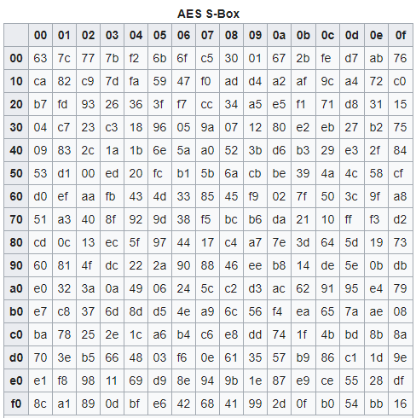
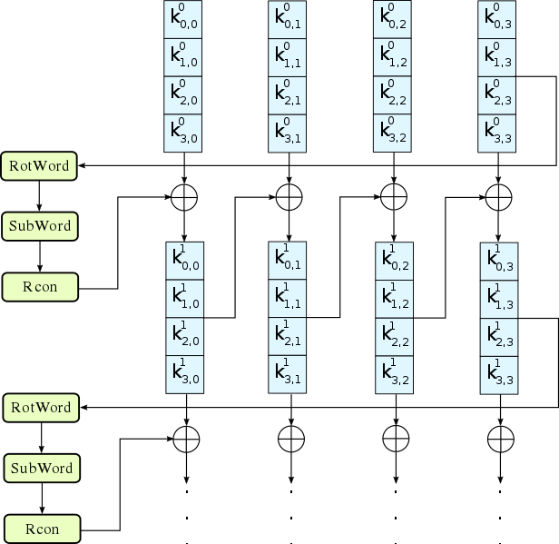
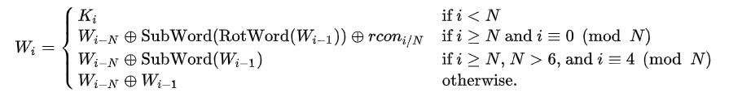
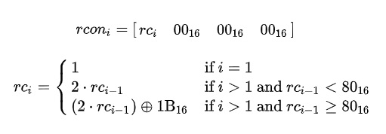
KeyExpansion
Expanding the given key with 128 bits to 1408 bits using Rijndael's key schedule.
RotWord
SubWord
Rcon
7

Slide 8
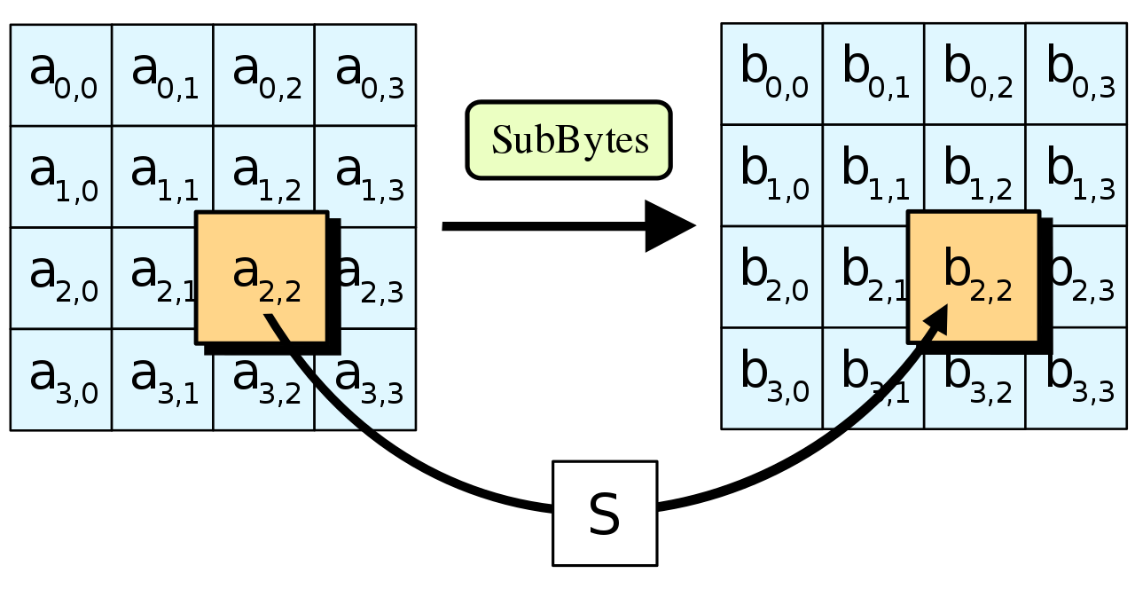
SubBytes
A non-linear substitution step where each byte is replaced with another according to a lookup table.
SubBytes
8

Slide 9
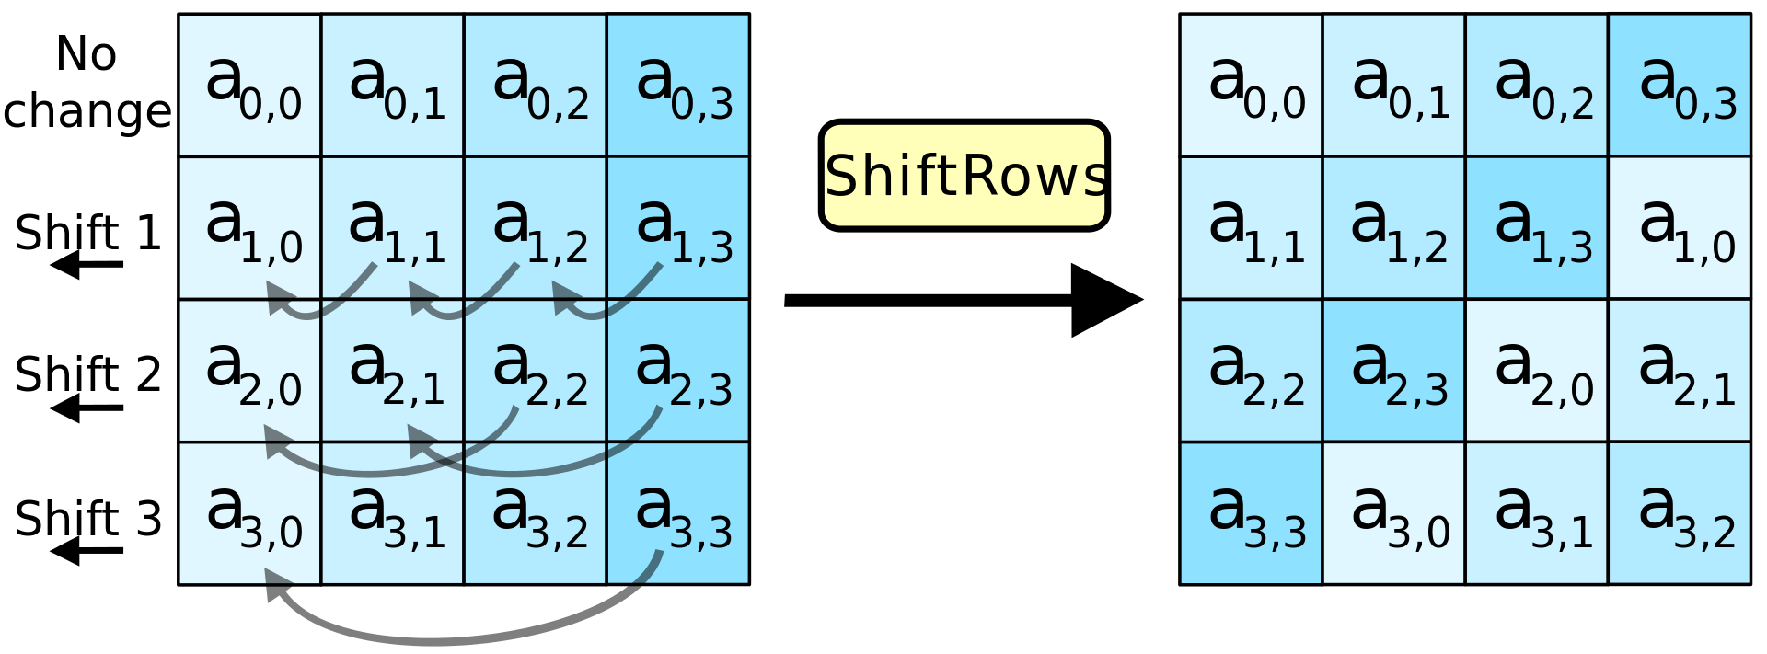
ShiftRows
A transposition step where the last three rows of the state are shifted cyclically a certain number of steps.
9

Slide 10
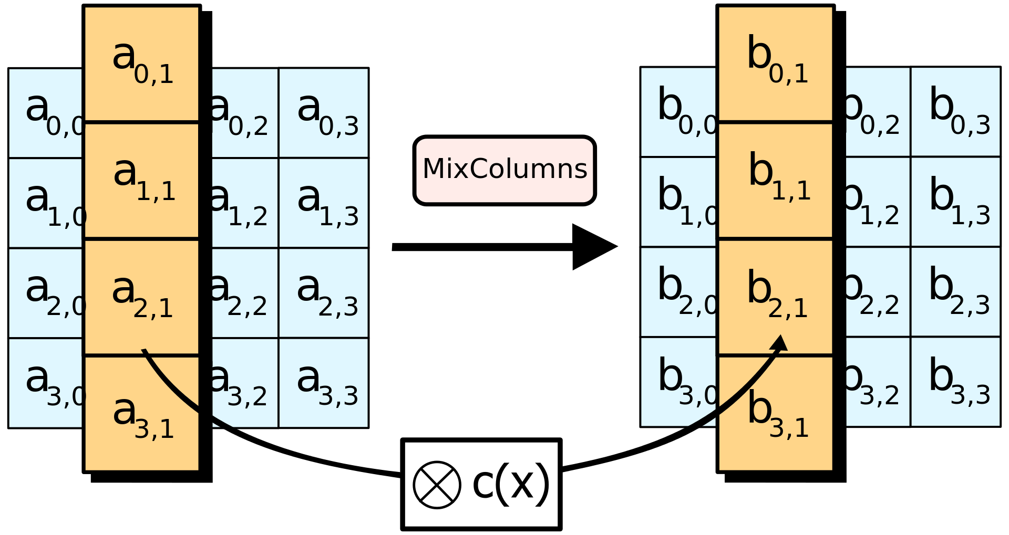
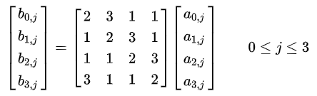
MixColumns (except for the last round)
A linear mixing operation which operates on the columns of the state, combining the four bytes in each column.
MixColumns
10

Slide 11
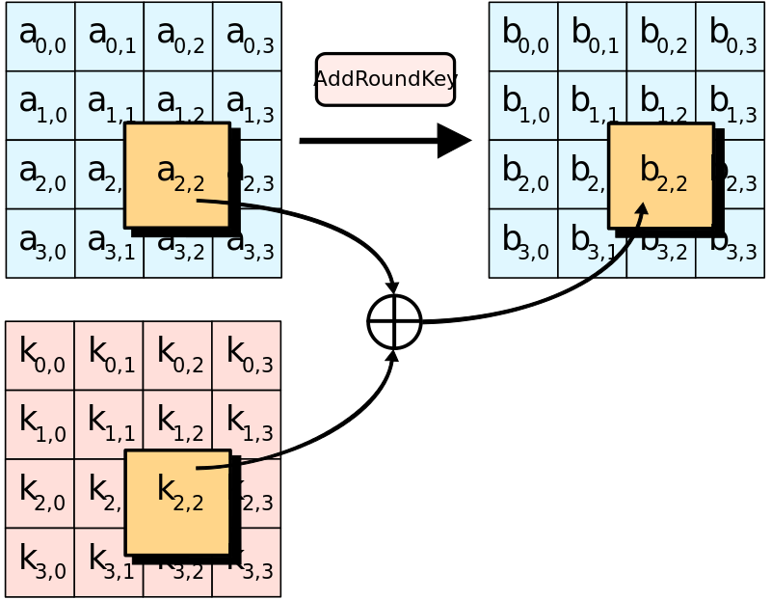
AddRoundKey
Each byte of the state is combined with a byte of the round key using bitwise xor. (twice in the first round - in the beginning and in the end of the round)
11

Slide 12
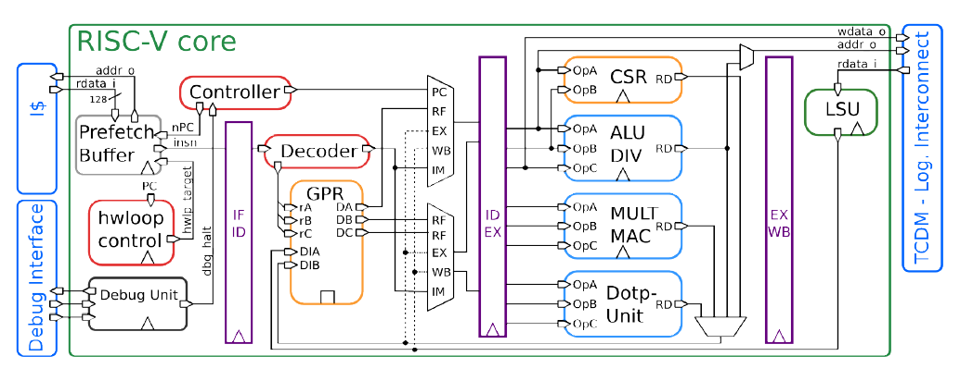
RI5CY Core
12

Slide 13
Workflow
Architecture
Flow
Modules
Implementation
Per module implementation
Specific module simulation.
Integration
Decode stage.
Write-Back stage.
Simulation
Full AES simulation.
Comparison to C implementation.
Extensions
Accessories
Automations
background
AES algorithm
Workflow
Performance
Simulation
13

Slide 14
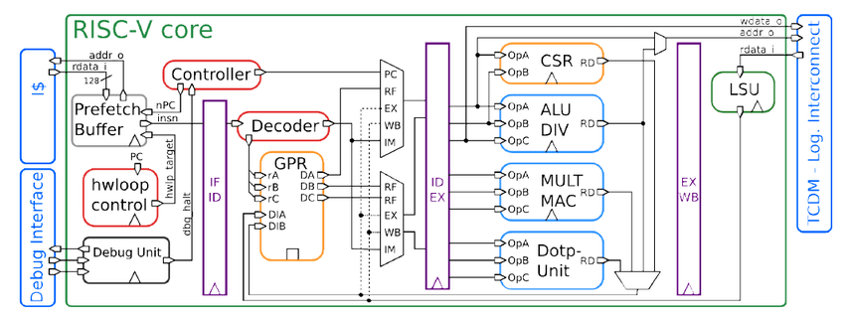
Base architecture - selected solution
128-bit data
AES register file
128-bit data
AES engine
AES WB
32-bit
128-bit key
128-bit ciphered
32-bit
14

Slide 15
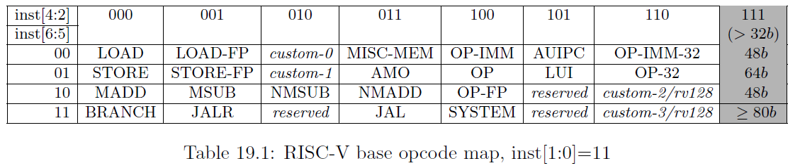
Commands structure
0x0
0x0
0x[0-31]
0x[0-3]
0x[0-3]
0x3b
Opcode
AES register (key or data)
AES function
RISCV register
Not in use
15

Slide 16
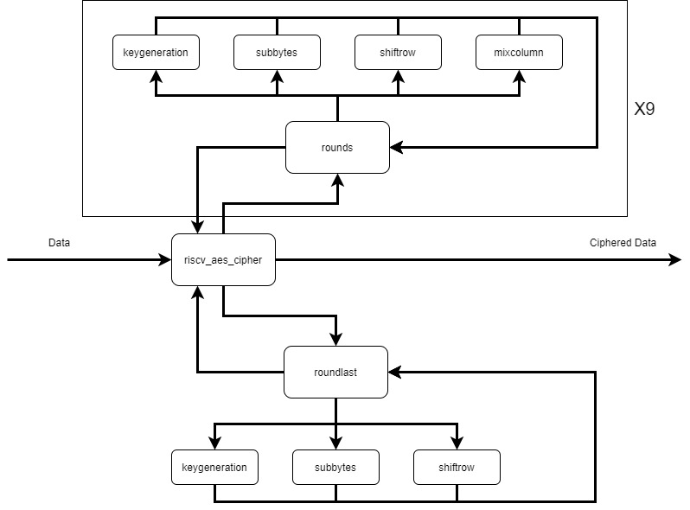
AES Engine Architecture
16

Slide 17
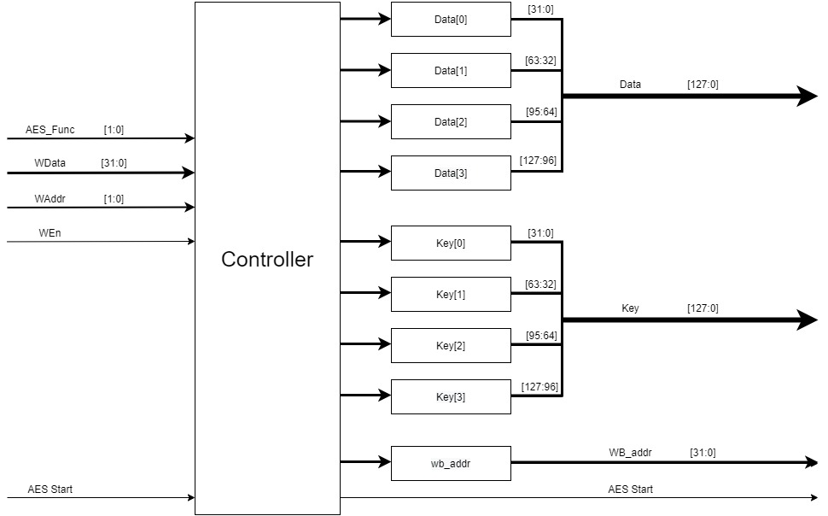
AES Register File Architecture
17

Slide 18
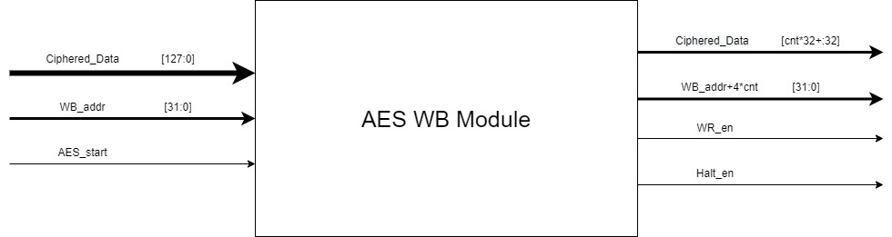
AES Write Back Architecture
18

Slide 19
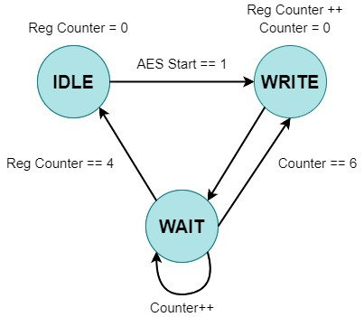
AES Write Back FSM
19

Slide 20
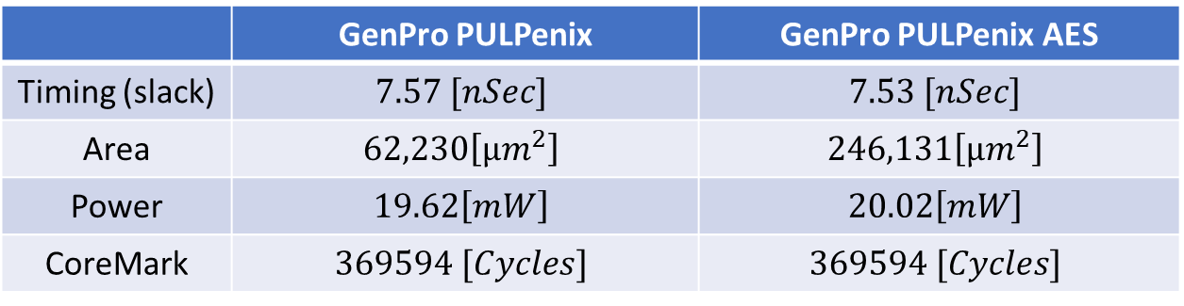
Performance
 | GenPro PULPenix | GenPro PULPenix AES
Timing (slack) | $$7.57 [nSec]$$ | $$7.53 [nSec]$$
Area | $$62,230\left[μm^{2}\right]$$ | $$246,131\left[μm^{2}\right]$$
Power | $$19.62\left[mW\right]$$ | $$20.02\left[mW\right]$$
CoreMark | $$369594 [Cycles]$$ | $$369594 [Cycles]$$
background
AES algorithm
Workflow
Performance
Simulation
20

Slide 21
Simulation
background
AES algorithm
Workflow
Performance
Simulation
21

Slide 22
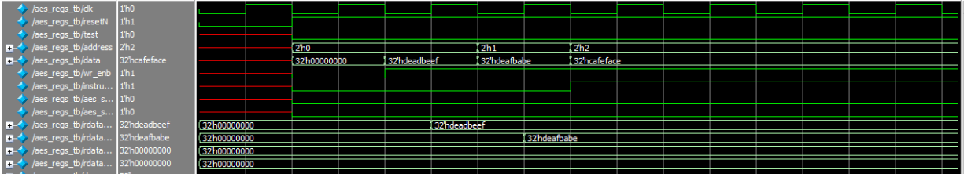

Register file simulation
22

Slide 23
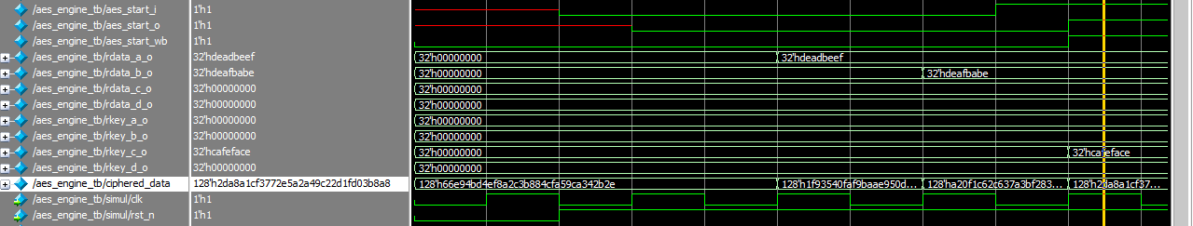
AES engine simulation
23

Slide 24
AES WB simulation
24

Slide 25
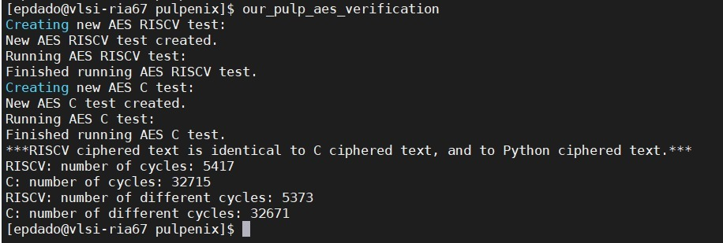
AES verification test
25

Slide 26
Conclusions
Successfully integrate AES engine inside RISCV core
Minimal effect on power and timing performance
Significant effect on area
Create user friendly AES commands support
Add compiling scripts that run before GNU’s compiler
Create AES verification script
Improve existing simulation scripts
Improve GenPro setup script
Add new simulation options
Add synthesis script
No need to open dc_shell to synthesize the project
26

